Slide 1
STRING
A character string type is one in which the values consist of sequences of characters.
Strings and Their Operations
The most common string operations are assignment, concatenation, substring
reference, comparison, and pattern matching.
A substring reference is a reference to a substring of a given string. Substring
references are discussed in the more general context of arrays, where the substring references are called slices.

Slide 2
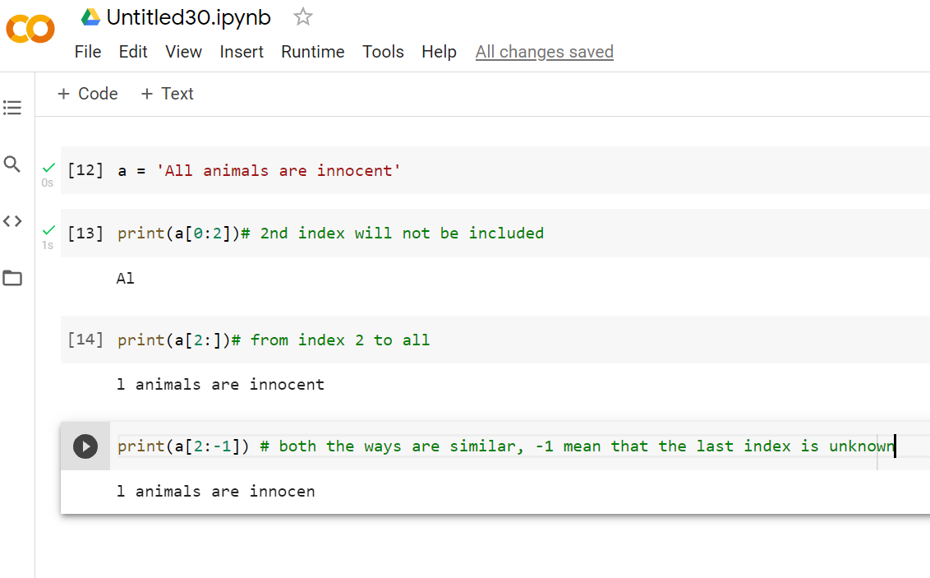
Sub-string (slice)

Slide 3
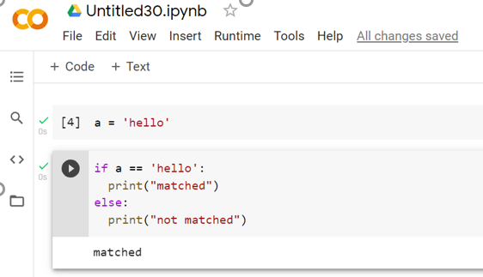
Pattern matching is another fundamental character string operation. In some languages, pattern matching is supported directly in the language.

Slide 4
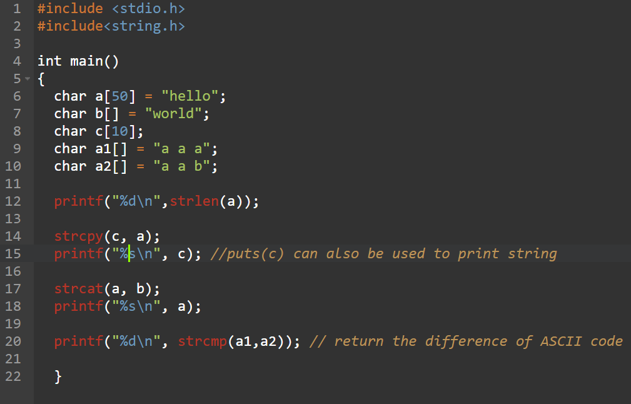
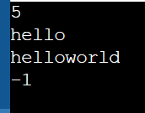
If strings are not defined as a primitive type, string data is usually stored in arrays of single characters and referenced as such in the language. This is the approach taken by C and C++.
C and C++ use char arrays to store character strings.

Slide 5
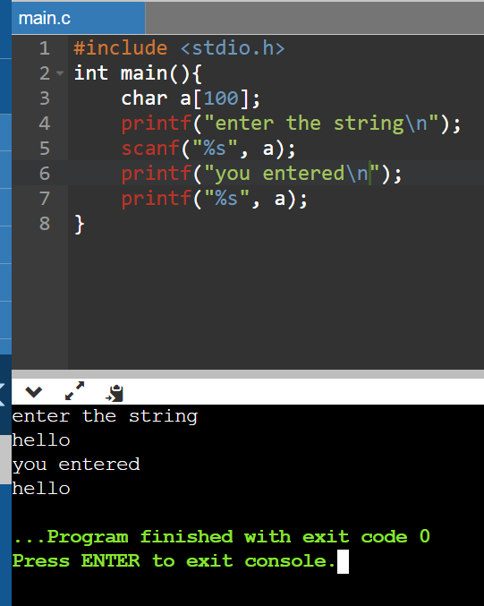
String Length Options
There are several design choices regarding the length of string values. First, the length can be static and set when the string is created. Such a string is called a static length string. Example java, python, c, c++ etc.
The second option is to allow strings to have varying length up to a declared and fixed maximum set by the variable’s definition, as exemplified by the strings in C and the C-style strings of C++. These are called limited dynamic length strings.

Slide 6
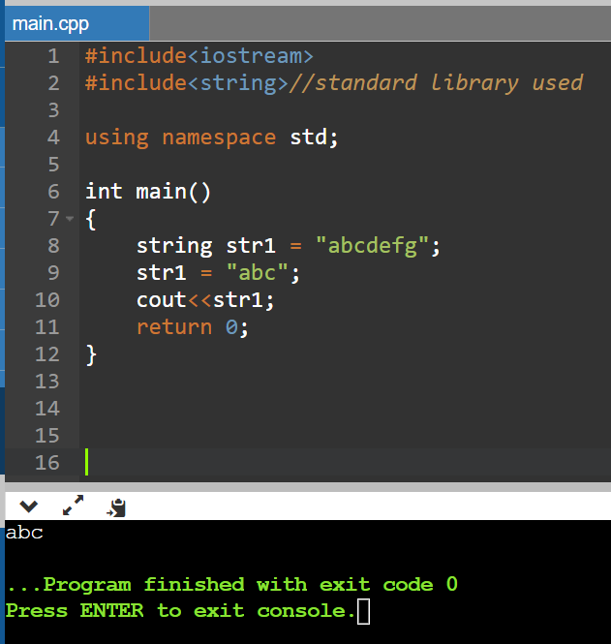
The third option is to allow strings to have varying length with no maximum, as in JavaScript, Perl, and the standard C++ library. These are called dynamic length strings. This option requires the overhead of dynamic storage allocation and deallocation but provides maximum flexibility. Dynamic length (may grow and shrink after allocation)

